Slide 1
TAKE FIVE Staff Training
GDPR Data Protection
FOCAL POINT
PASSWORD SECURITY
Notes:
Title slide = Take 5 minutes to deliver this reinforcement training.

Slide 2

Please create a new password...
Password strength: WEAK
Please try again
TAP TAP TAP TAP * @ $ TAP TAP !!! TAP TAP TAP 123
Password strength:
ADEQUATE
Next reset due - tomorrow.
Notes:
Facilitator Notes: Acknowledge that password policies can make users despair. “So why do we need them and what does the latest guidance say?”

Slide 3
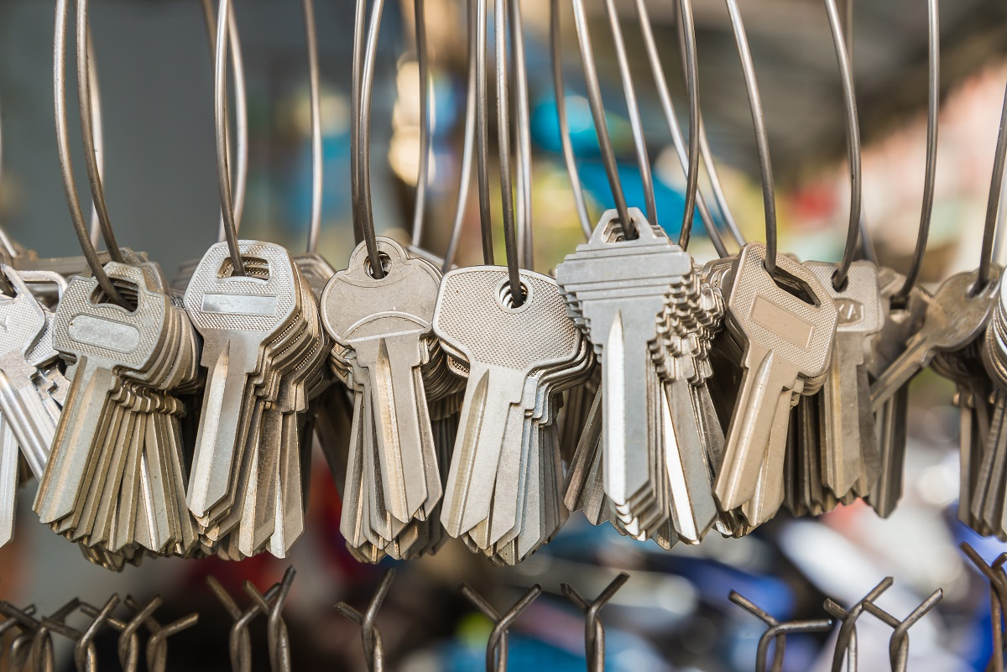
Passwords are the keys to access systems & personal data for criminals to commit e.g. fraud and identity theft.
Notes:
But… however frustrating, passwords are still an important security feature. Remember, it is a criminal act for ANY UNAUTHORISED person to access data they are not suppose to.

Slide 4

Dec 2017… 1.4 billion passwords were found dumped in a cyber-criminal archive.
Notes:
Password breaches over many years are collected and shared by criminals on the Dark Web… open for anyone to access and exploit.

Slide 5
Dec 2017… 1.4 billion passwords were found dumped in a cyber-criminal archive.
The top password is still 123456, followed by 123456789, qwerty, password and 111111.
Notes:
Unfortunately, years of advice on choosing strong passwords is still being ignored. The top password is, depressingly, still 123456, followed by 123456789, qwerty, password and 111111.

Slide 6
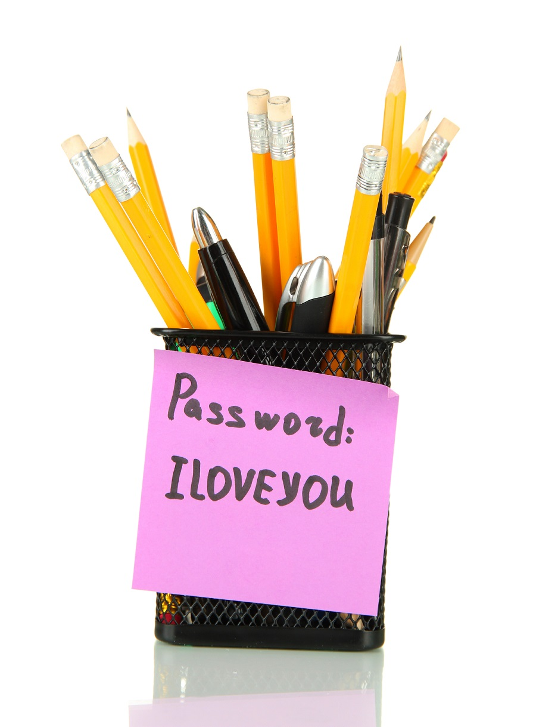
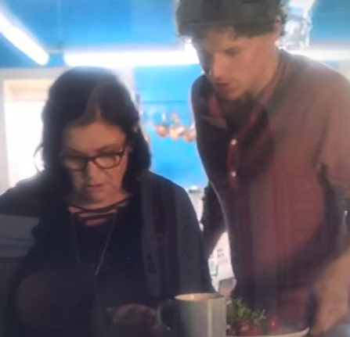

Ways passwords get leaked…
Someone finds it written down
It’s personal & easy to guess
Password cracking software
“Her password is Leo1234 – same as all her accounts.
Notes:
Some of the ways passwords are leaked/cracked and can get an organisation/school into trouble include:
MOUSE CLICKS 1-3:
The main ones shown on the slide:
People finding passwords which have been stored insecurely, such as handwritten on paper and hidden close to a device;
Password guessing, perhaps using personal information ‘cribs’ such as name, date of birth, or pet names - (the picture shown is from ITV 2018 series Delicious when Sam’s son Michael gives Gina (Dawn French) his mother’s password. Leo is Sam’s dead husband’s name;
Password cracking software (widely available) also know as brute-force attacks: the automated guessing of large numbers of passwords until the correct one is found.
Others include:
Social engineering e.g. phishing, coercion;
Intercepting a password as it is transmitted over a network;
‘Shoulder surfing’, observing someone typing in their password at their desk;
Installing a keylogger to intercept passwords when they are entered into a device;
Searching an enterprise’s IT infrastructure for electronically stored password information.

Slide 7
How good are we at looking after our passwords?
POLL – HAVE YOU EVER…
Shared one of your passwords with a co-worker? Or with your partner?
Or used the same password for more than one account?
Notes:
But, the most common leaks can be down to us…
Stand up if you’ve ever shared a password with a co-worker.
Stand up if you’ve ever shared a password with your partner.
Stand up if you use the same password for more than one account…
You’re not alone… See next slide.

Slide 8

Keep your friends close & your passwords closer…
95%
73%
59%
Say they share passwords with other people
(76% with partner 22% with a co-worker).
Say they re-use passwords i.e. use them for more than one login.
Say they don’t reset passwords after they’ve shared them.
Notes:
According to a 2016 survey of over 1000 US consumers by LastPass (the provider of a popular password management services);
https://blog.lastpass.com/2016/02/infographic-keep-your-friends-close-your-passwords-closer-2.html.

Slide 9
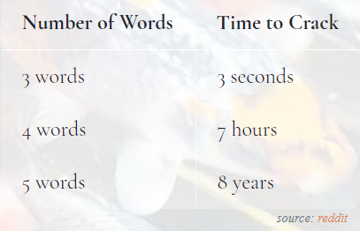

How important are the actual passwords?
Cracking ‘pass phrases’ that are based on random words you’d find in a dictionary…
More is more!
But, avoid using a quote, a bible passage or a phrase from a film/song, as times will be much shorter.
Notes:
Times are reducing all the time – and common phrases, bible passages or song/film quotes… well hackers know these too, so they will be easy for them to spot/decode.

Slide 10
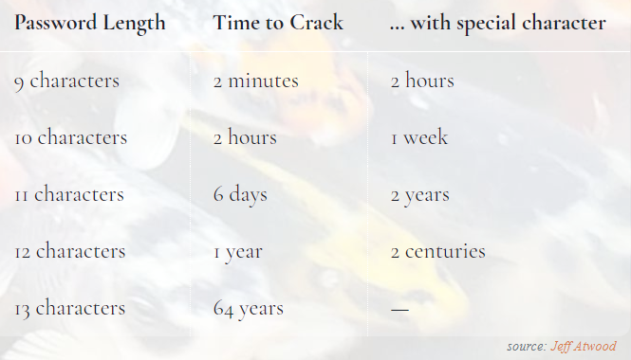
Does size really matter?
YES! Here are estimates for passwords that have a mix of 9+ characters: a-z, A-Z, 0-9
NB: times are shorter if actual words, names, places or ‘keyboard runs’ e.g. asdfghjkl are used.
Notes:
The longer the password, as long as it is random, the harder and longer it is for computer programmes to ‘crack’,

Slide 11

Staff and student password challenge
Come up with a new long password e.g. four or more random words, avoiding personal information, well known quotes or song lyrics.
Add some uppercase letters, symbols or numbers if you wish (But avoid making anything too complex, so that you can still remember it).
Add an identifier to identify which login the password is for, so every password you use is different.
Get feedback from your teacher.
Repeat 1-3 to create another new password that no-one but you will know.
Notes:
Tips for teachers – use this exercise with your students.

Slide 12
Summary for staff and other users
Make passwords hard to guess;
Make them long, to keep them strong (aim for 10+ characters);
Use a different password for each account;
Never share your password;
Change your password if it is no longer secret or after any suspicious activity is detected on your account.
Notes:
Summary

Slide 13
Tips for school IT/policy makes
Simplify rules that require frequent changes and complex validations;
Encourage longer ‘random’ passwords;
Keep technological checks in place for weak/common passwords and for possible attacks or misuse;
Reinforce policies about user responsibilities e.g. not sharing passwords and keeping work and personal passwords different.
Notes:
Tips

Slide 14


Any questions
Notes:
Questions

Slide 15

Thank you!
Need independent advice?
Email: dpo@dataprotecteion.education
Tel: 0800 0862018
Notes:
Thank you

